Slide 1
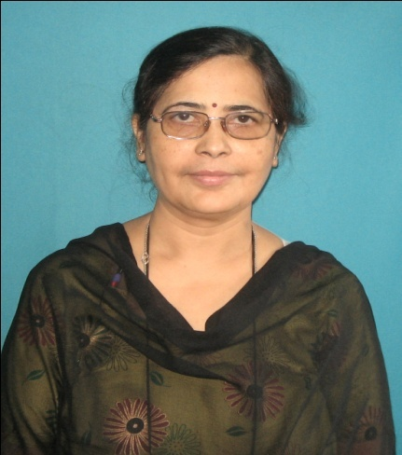
CV OF DR DIPASRI BHATTACHARYA

Slide 2
SHORT BIODATA OF DR.DIPASRI BHATTACHARYA Passed MD From Calcutta University, Member of National Academy of Medical Sciences, Fellow of Indian Academy of Pain Medicine. Professor & HOD, Dept of Anaesthesiology Critical Care & Pain, R.G.KAR Medical College, Kolkata, President ISA, WB State Branch, 2016- 2017, President WBSSP, 2018-2019, Sc Co chairperson ISACON 2017, Faculty Member of NBE Board, WBUHS, Awarded “AMBASSADOR FOR PAIN MANAGEMENT”, ICRA 2016 Coordinator, CANCER PAIN SIG, Director of FIPM course R.G.Kar Medical College affiliated to WBUHS from 2017, Published 62 Articles in the Journals of National & International Level, Peer Reviewer of many Journals of State Level, national Level, Subject of Interest- Pain, Regional Anaesthesia, Critical care

