Slide 1
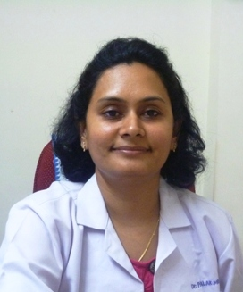
Dr Palak Mehta
MD, FIPP, FIAPM
MD ( Anaesthesiology from BJMC , Ahmedabad) -July’2006
FIPP (Fellow in Intervention Pain Practice) Netherland- June’ 2011
FIAPM ( India ) – February 2018
Director : Pain Care Clinic, Ahmedabad
Award : Pain Physician of The Year 2018-19 @ ICRA-PAIN – 2019 Nagpur
Award :Pain Ambassador of 2016-2017 @ ICRA-PAIN -2017 PUNE
Executive committee Member : Indian society for Study of PAIN ( ISSP)
Visiting lecturer/ Faculty : Padjadjran University, Bandung, Indonesia
Observer in FIPP Exam in Miami, USA ( Feb- 2012) & Maastricht , Netherland
( June-2013)
Publications : 6 National & 2 International
Contributed Chapter in Spanish Pain Medicine book
Author of “ Handbook Interventional Pain Management” & Chief Editor of
“ How to start & run a Pain Clinic”
Faculty at various National & International Conferences.
Organizing Secretary of 7th SARPS Congress held at Ahmedabad, INDIA in 2014

