Slide 2

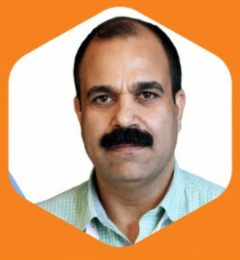
DR ROHIT –LAHORI
Appeal to vote for GC Member -ISSP
Academic credentials:-DA ,FIPM ,CPM,IDIPM(France & South Korea )
Vision:-To work for the ISSP to Increase awareness and education about Pain Medicine
Important Posts held : -
Incharge of the Pain and Palliative care Gov. Hospital Gandhinagar Jammu (J&k)
First Nodal officer of Palliative care for J&K
Editorial Board member of JORA Pain
Member of SIG for formation of ISSP Guidelines for:-
Interventional Pain Procedure coding
Consent of Interventional Pain Procedures
Antibiotic Policy for Interventional Pain Procedures
Consent for Opioids
Organizing secretary of ICRA Pain 2018 Jammu
Kindly vote and support me for the post of GC member of ISSP at ISSPCON 2020 Ahmedabad
Elections on 8th Jan 2020
Please bring your ISSP ID Card for voting

